Slide 1







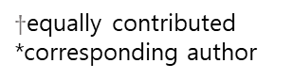

Energy-transfer dynamics of photosystems
¹⁾
Eunchul Kim^{1,2)}$†$
Daekyung Lee³⁾$†$
Souichi Sakamoto⁴⁾$†$
Ju-Yeon Ho^{4,7)}
Mauricio Vargas⁵⁾
Akihito Ishizaki^{4,6*)}
Jun Minagawa^{1,2*}
Heetae Kim^{3*}
³⁾
^{2,6)}
⁵⁾
⁷⁾
⁴⁾
$†$equally contributed
*corresponding author
Notes:
안녕하세요. 저는 성균관대학교 통계물리연구실의 이대경입니다. 오늘 저는 네트워크의 커뮤니티 구조에 대해 다른 시각으로 접근한 연구를 발표하려고 합니다.

Slide 2
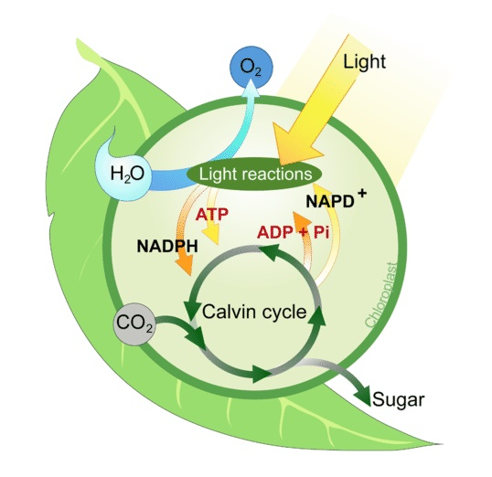
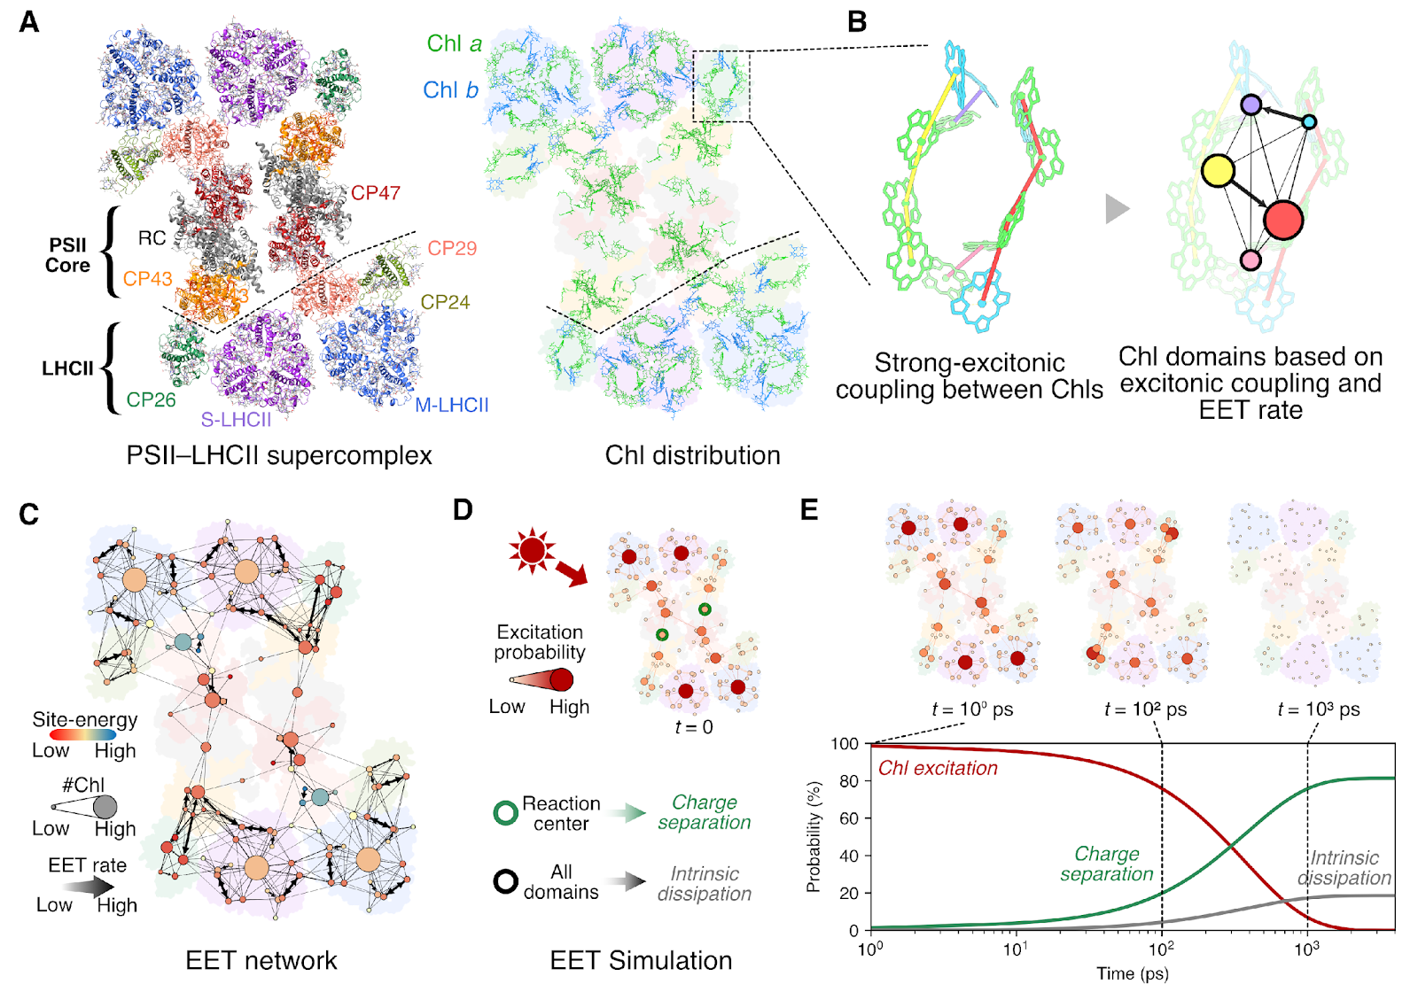
Photosystem II
Introduction
Functional and structural unit of protein complexes that carry out photosynthesis: photosystem
Photosystem II: A system that transfers light energy to the next process in the form of excited electrons.
Forms a network structure of various layers through the combination of chlorophyll

Slide 3
Photosystem II Network
Introduction
reaction center
(reaction center)
The basic unit of a Photosystem II network: Domain
Individual domains made up of multiple chlorophylls are defined as nodes
The light energy absorbed by each node moves to the reaction center and is transmitted through the network structure.

Slide 4
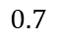
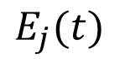

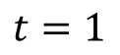
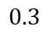
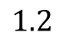

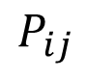
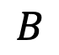
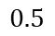
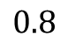
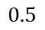
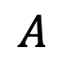

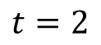

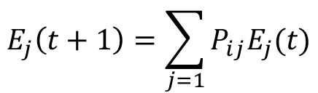
Absorbing Markov process
Method
Network
Absorbing state
$$E_{j}\left(t+1\right)=\sum_{j=1}{P_{ij}E_{j}(t)}$$
$$E_{j}(t)$$
$$P_{ij}$$
Other nodes
Dissipation
$$A$$
$$1$$
$$0.5$$
$$0.8$$
$$A$$
$$0.5$$
$$0.3$$
$$B$$
$$1$$
$$1.2$$
$$B$$
$$0.7$$
Charge
Separation
$$t=1$$
$$t=2$$
Reaction center
Energy transfer process in photosynthetic networks: Markov process
The energy of each node changes depending on the transition probability at every time step (0.2 ps).
At each step, a portion of the total energy is lost, and a portion of the energy in reaction center is transferred.

Slide 5
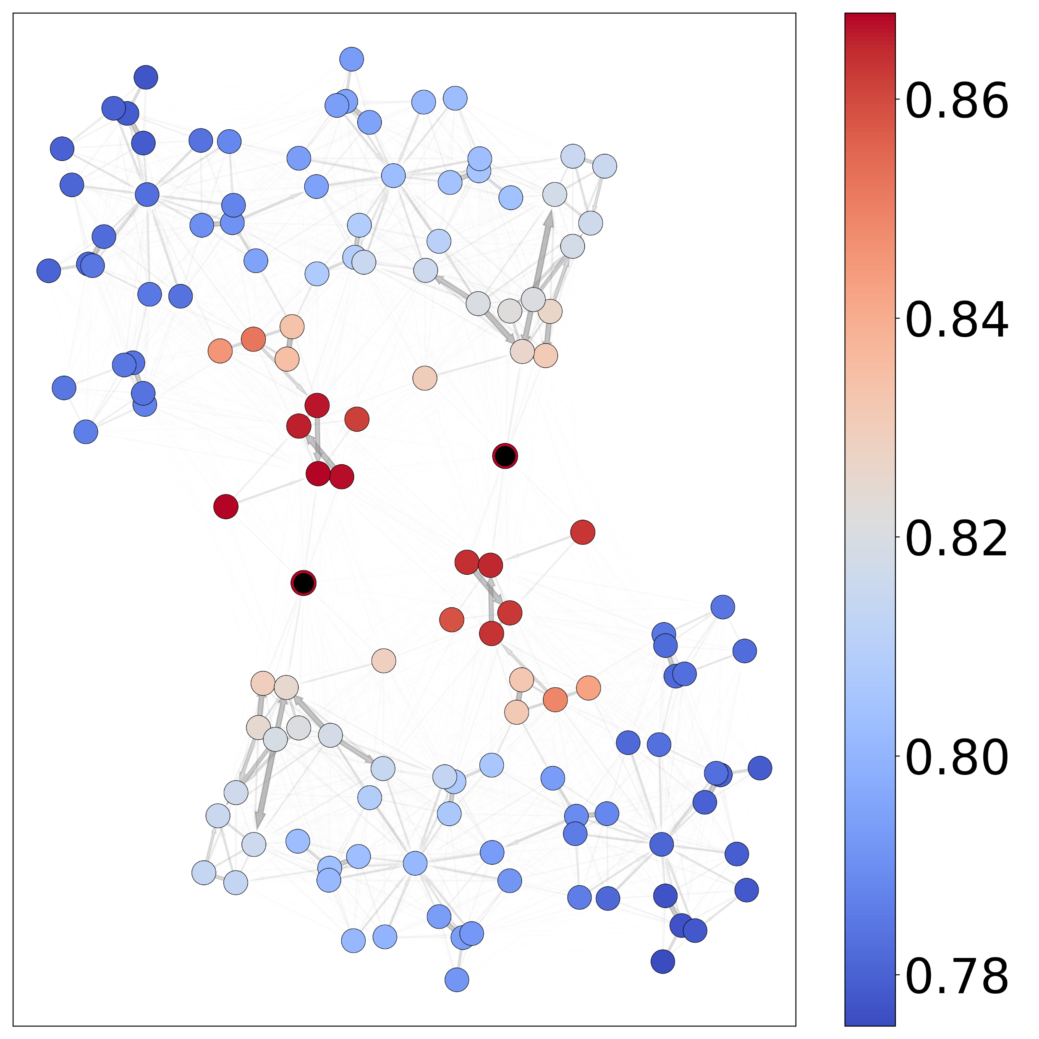
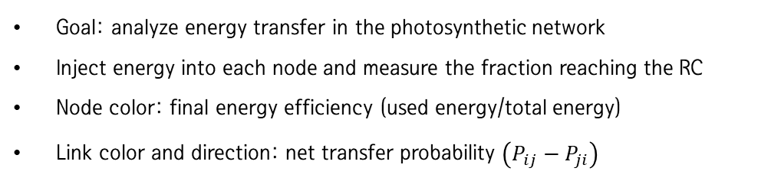
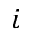
Yield of individual nodes
Analysis
charge separation
$$i$$
simulation
dissipation
Goal: analyze energy transfer in the photosynthetic network
Inject energy into each node and measure the fraction reaching the RC
Node color: final energy efficiency (used energy/total energy)
Link color and direction: net transfer probability $\left(P_{ij}−P_{ji}\right)$

Slide 6
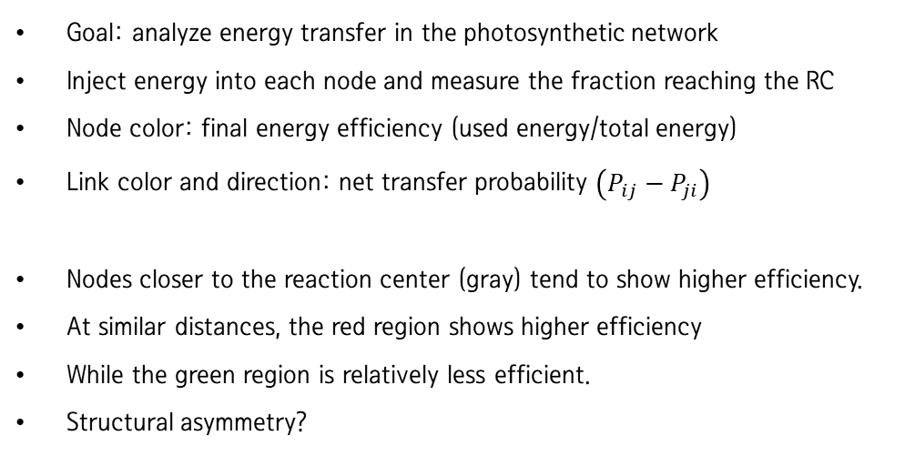
Yield of individual nodes
Analysis
charge separation
$$i$$
simulation
dissipation
Goal: analyze energy transfer in the photosynthetic network
Inject energy into each node and measure the fraction reaching the RC
Node color: final energy efficiency (used energy/total energy)
Link color and direction: net transfer probability $\left(P_{ij}−P_{ji}\right)$
Nodes closer to the reaction center (gray) tend to show higher efficiency.
At similar distances, the red region shows higher efficiency
While the green region is relatively less efficient.
Structural asymmetry?

Slide 7
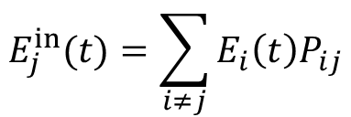
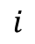
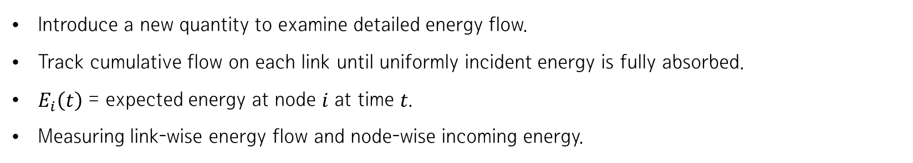
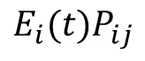
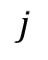
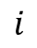
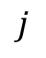
Cumulative flow analysis
Analysis
Introduce a new quantity to examine detailed energy flow.
Track cumulative flow on each link until uniformly incident energy is fully absorbed.
$E_{i}\left(t\right)$ = expected energy at node 𝑖 at time 𝑡.
Measuring link-wise energy flow and node-wise incoming energy.
$$i$$
$$j$$
$$E_{i}{(t)P}_{ij}$$
$$i$$
$$j$$
$$E_{j}^{in}(t)=\sum_{i≠j}{E_{i}\left(t\right)P_{ij}}$$
= Energy flow from 𝑖 to 𝑗 at time 𝑡
= Total energy incident on node 𝑗 at time 𝑡

Slide 8
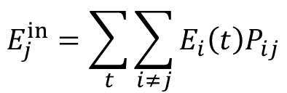
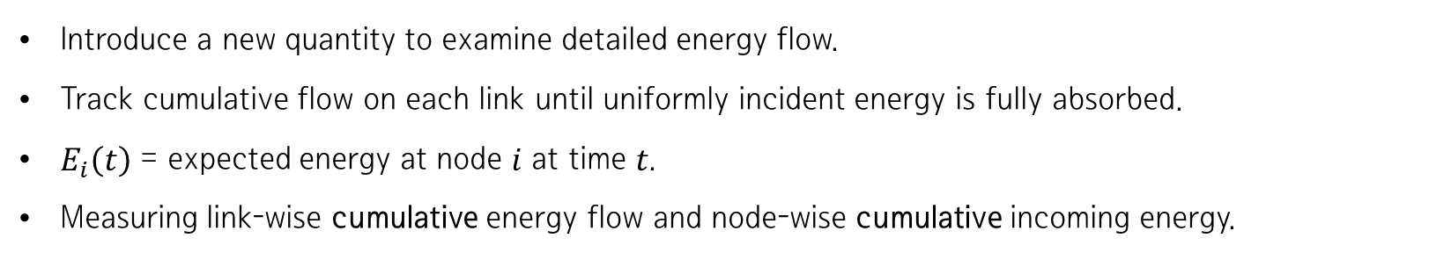
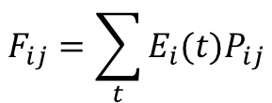
Cumulative flow analysis
Analysis
Introduce a new quantity to examine detailed energy flow.
Track cumulative flow on each link until uniformly incident energy is fully absorbed.
$E_{i}\left(t\right)$ = expected energy at node 𝑖 at time 𝑡.
Measuring link-wise cumulative energy flow and node-wise cumulative incoming energy.
$$i$$
$$j$$
$$F_{ij}=\sum_{t}{E_{i}{(t)P}_{ij}}$$
$$i$$
$$j$$
$$E_{j}^{in}=\sum_{t}{\sum_{i≠j}{E_{i}\left(t\right)P_{ij}}}$$
= Cumulative energy flow from 𝑖 to 𝑗 at time 𝑡
= Cumulative total energy incident on node 𝑗 at time 𝑡

Slide 9
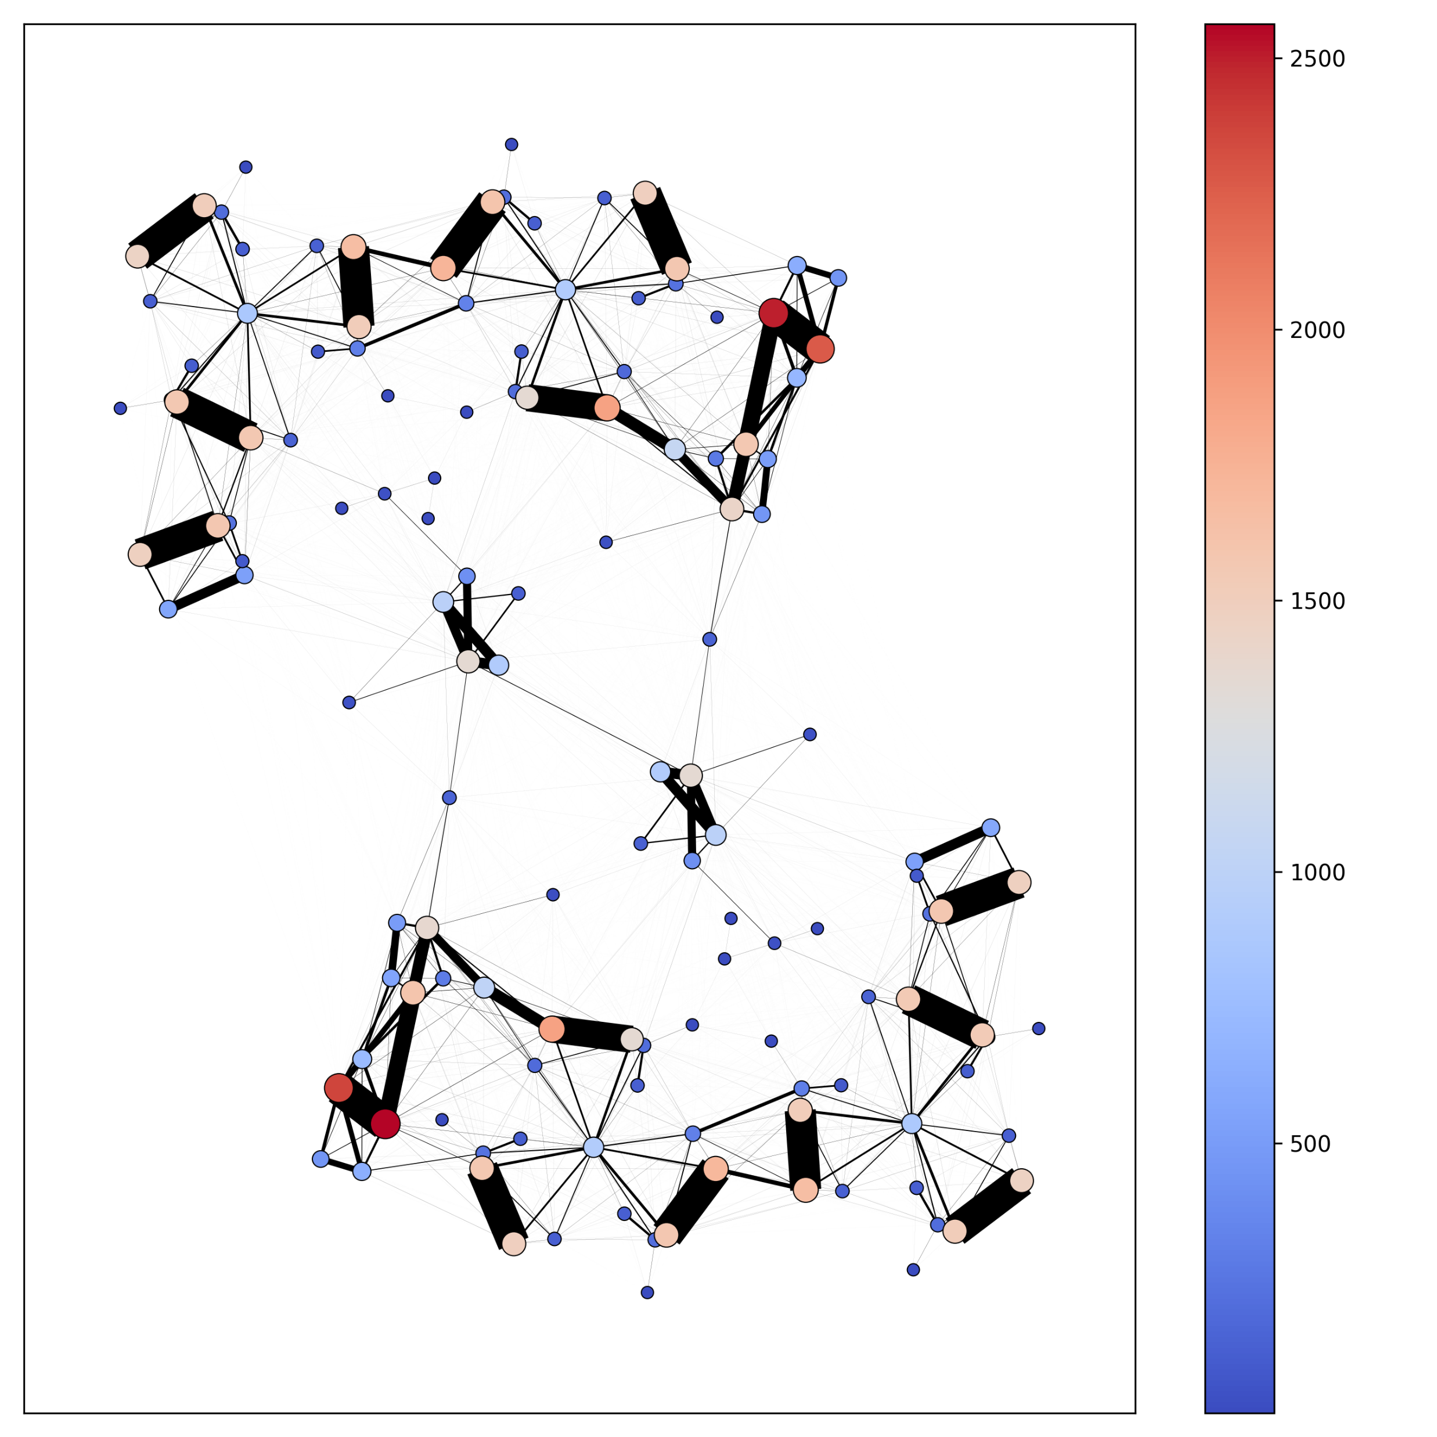
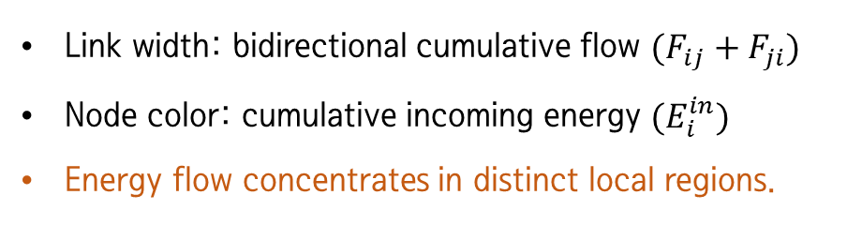
Cumulative flow analysis
Analysis
Link width: bidirectional cumulative flow $(F_{ij}+F_{ji})$
Node color: cumulative incoming energy $(E_{i}^{in})$
Energy flow concentrates in distinct local regions.

Slide 10
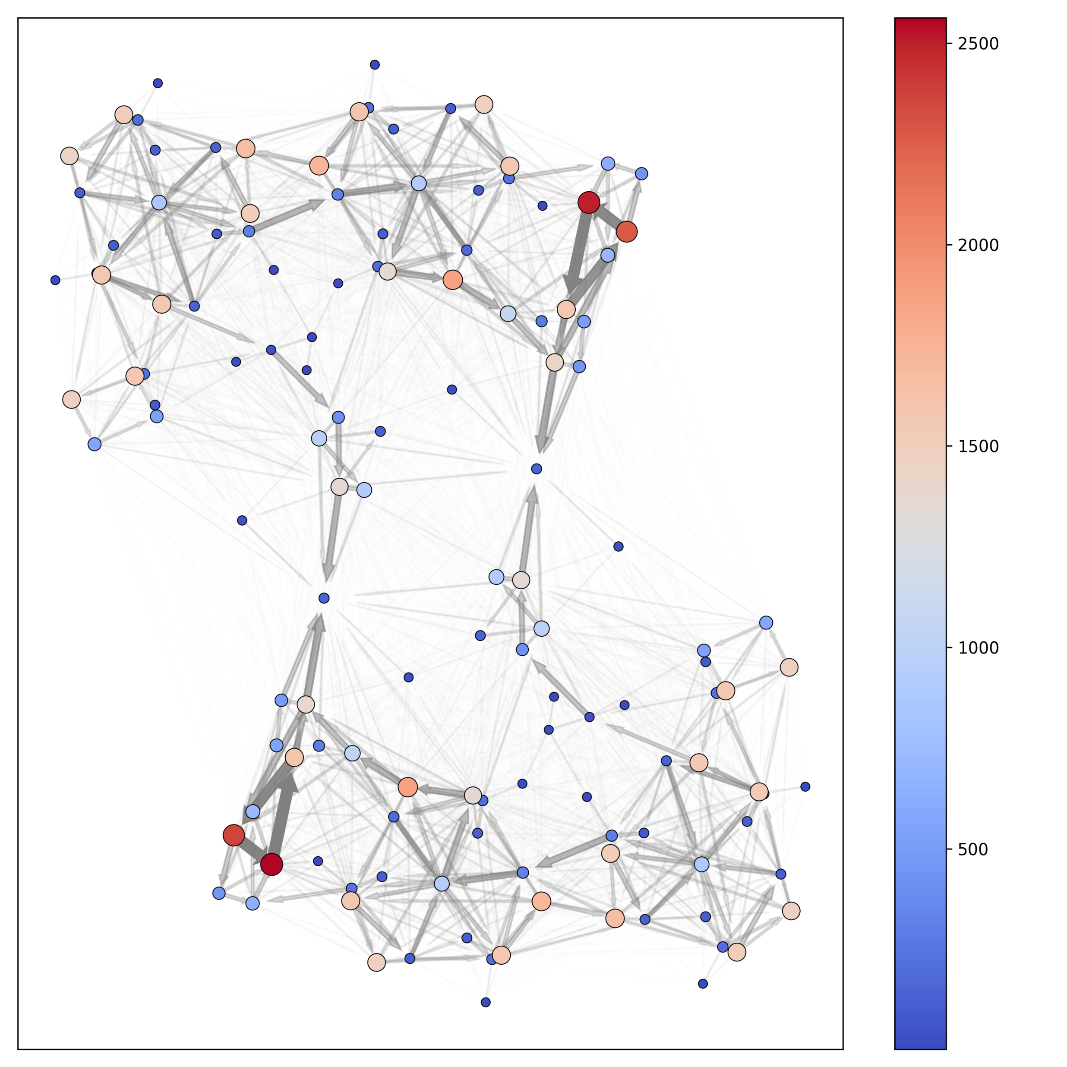
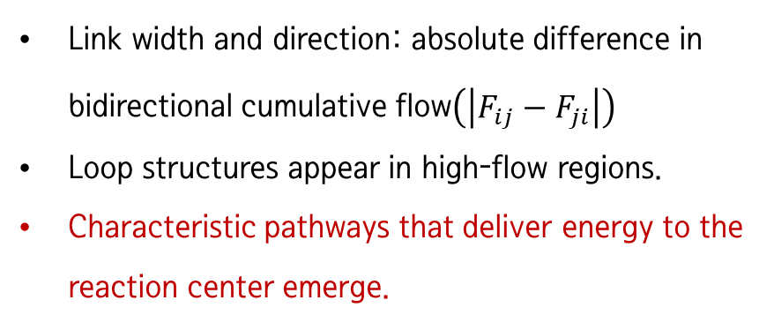
Cumulative flow analysis
Analysis
Link width and direction: absolute difference in bidirectional cumulative flow$\left(\left|F_{ij}−F_{ji}\right|\right)$
Loop structures appear in high-flow regions.
Characteristic pathways that deliver energy to the reaction center emerge.

Slide 11
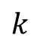

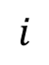
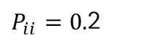
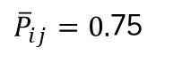
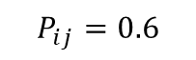
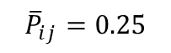
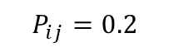
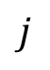
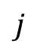
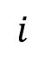
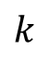
Effective loop analysis
Analysis
In energy flow analysis, loop structures of various lengths exist.
Energy originating from one node passes through another node and returns to the original node.
N=2
N=3
Pure transition probability $(\overline{P})$: transition matrix that excludes dwelling probability and counts only movement to other nodes.
Diagonal element of ${\overline{P}}^{N}$= fraction of energy returning to the original node after passing through 𝑁−1 other nodes.
$$P_{ij}=0.2$$
$$j$$
$${\overline{P}}_{ij}=0.25$$
$$j$$
$P_{ii}=0.$2
$$i$$
$${\overline{P}}_{ii}=0$$
$$i$$
$$k$$
$$k$$
$$P_{ij}=0.6$$
${\overline{P}}_{ij}=0.$75

Slide 12
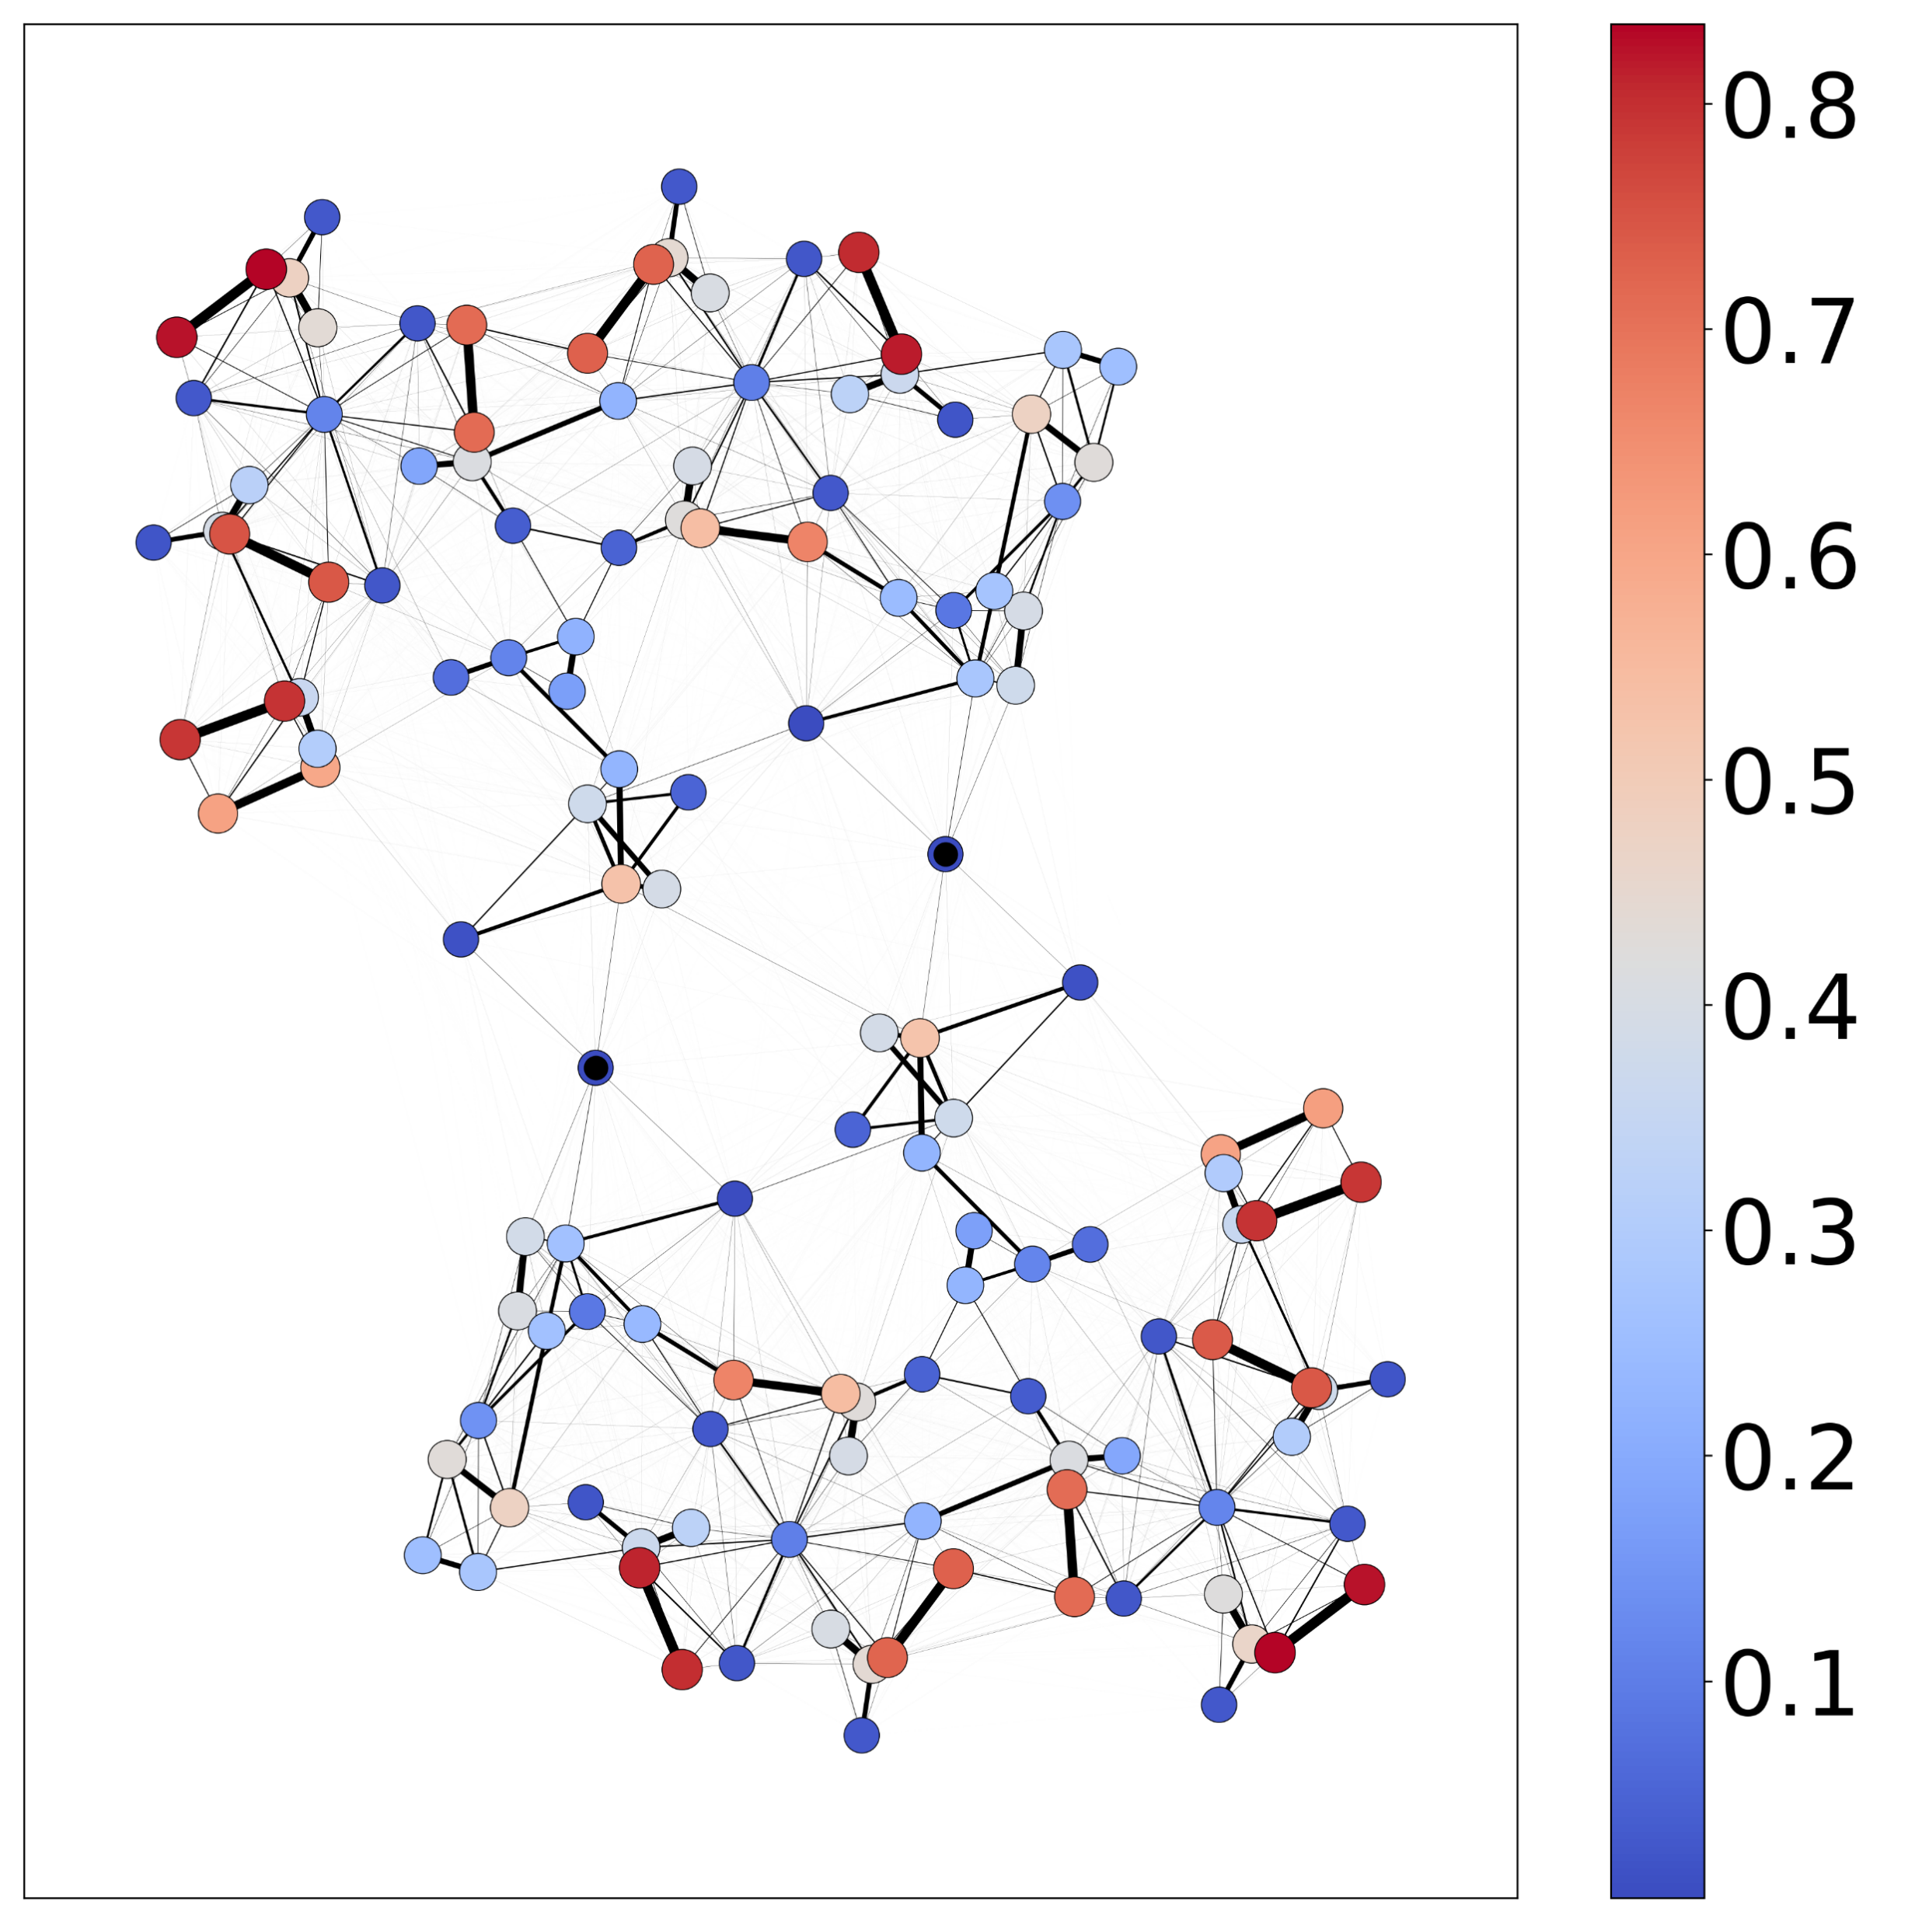
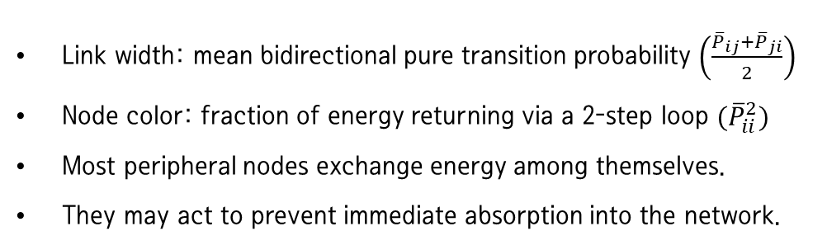
Effective loop analysis
Analysis
Link width: mean bidirectional pure transition probability $\left(\frac{{\overline{P}}_{ij}+{\overline{P}}_{ji}}{2}\right)$
Node color: fraction of energy returning via a 2-step loop $({\overline{P}}_{ii}^{2})$
Most peripheral nodes exchange energy among themselves.
They may act to prevent immediate absorption into the network.

Slide 13
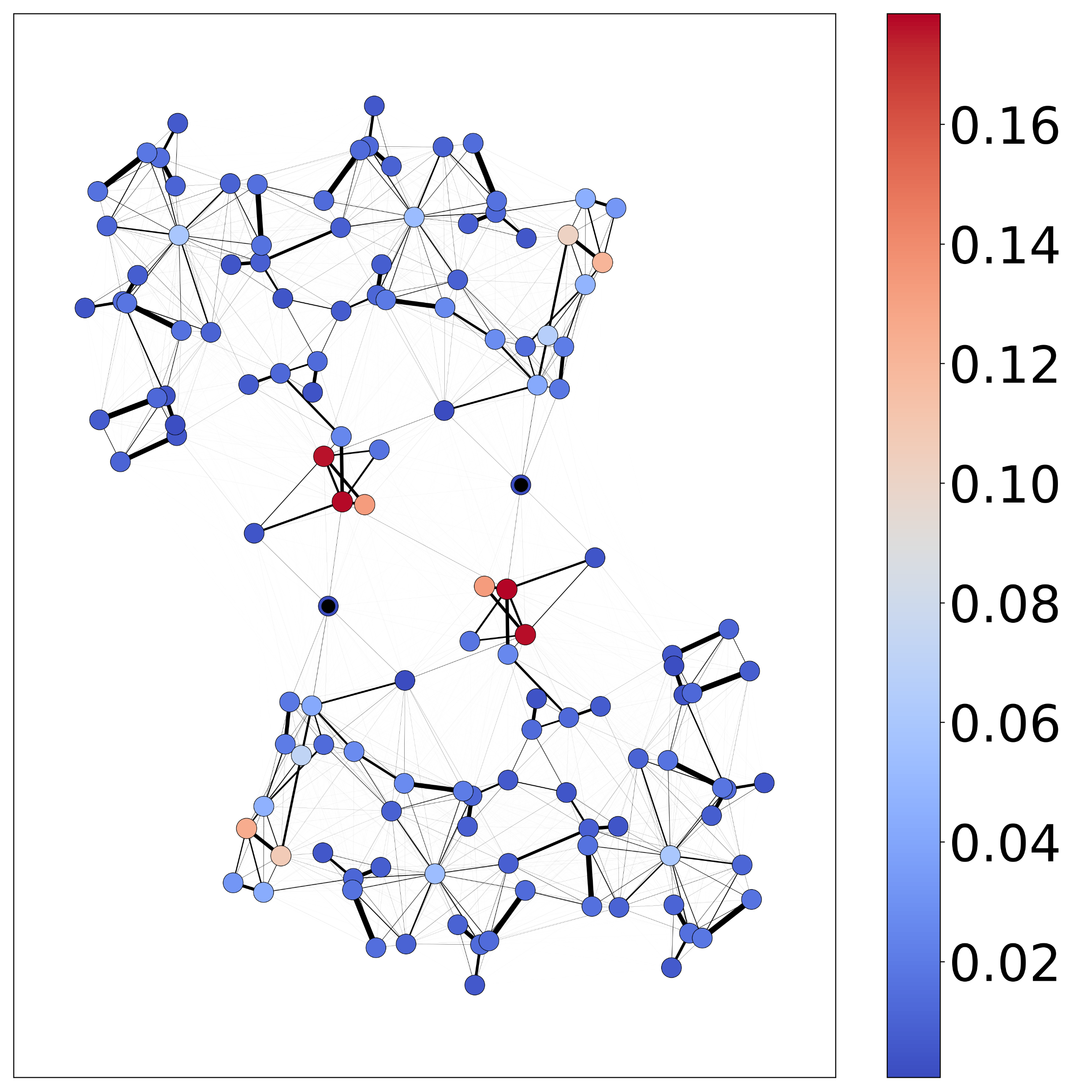
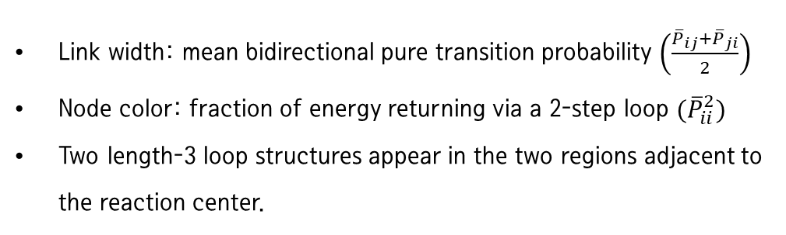
Effective loop analysis
Analysis
Link width: mean bidirectional pure transition probability $\left(\frac{{\overline{P}}_{ij}+{\overline{P}}_{ji}}{2}\right)$
Node color: fraction of energy returning via a 2-step loop $({\overline{P}}_{ii}^{2})$
Two length-3 loop structures appear in the two regions adjacent to the reaction center.

Slide 14

Energy-transfer dynamics of photosystems
Summary
Analyze energy flow in photosystem network
Perform simulation with Absorbing Markov process
Energy efficiency analysis of individual nodes
Discover characteristic paths through cumulative energy flow analysis
Identify the area where energy resides through loop analysis
Application and expansion to transportation networks, power grid networks, etc.

